Slide 1

First Portfolio: Pizza Sales
Data Analysis
August 4, 2023
By Taisiya Karipidis

Slide 2

Agenda
Pizza Sales Dataset
Problem Statements
SQL Queries
Visualizations (PBI)

Slide 3
Welcome to my portfolio showcasing my proficiency in SQL and Power BI!
In this project, I harnessed the 'Pizza Sales' database to delve into key performance indicators (KPIs) of a pizza company. Using MS SQL, I analyzed vital metrics such as total revenue, average order value, total pizzas sold, total number of orders and average number of pizzas per order.
To visually represent these insights, I used Power BI to create interactive charts unveiling daily and monthly sales trends, pizza sales by category and pizza size.
The first dashboard provides a comprehensive overview, while the second highlights the top 5 best and worst sellers based on revenue, quantity and total orders.
This portfolio is meant to demonstrate my abilities to transform raw data into actionable business insights.

Slide 4
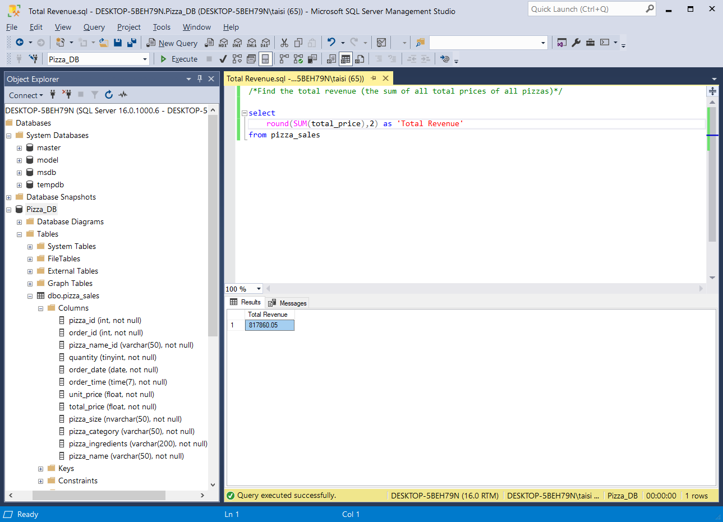
SQL Queries
Analyze KPIs:
Total Revenue
Average Order Value
Total Pizzas Sold
Total Orders
Average Pizzas Per Order

Slide 5
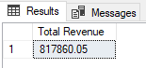
SQL Queries: Total Revenue
select
round(SUM(total_price),2) as 'Total Revenue'
from pizza_sales

Slide 6
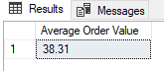
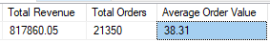
SQL Queries: Average Order Value
1) Using GROUP function:
SELECT round(AVG(order_total),2) AS 'Average Order Value'
FROM (
SELECT order_id, SUM(quantity * unit_price) AS order_total
FROM pizza_sales
GROUP BY order_id
) AS order_totals;
2) Using division (the total revenue / total number of orders):
SELECT
ROUND(SUM(total_price), 2) AS 'Total Revenue’,
COUNT(DISTINCT order_id) as 'Total Orders',
ROUND(SUM(total_price) / COUNT(DISTINCT order_id), 2) AS 'Average Order Value'
FROM pizza_sales;

Slide 7
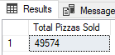
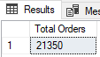
SQL Queries
1) Total Pizzas Sold:
select
sum(quantity) as 'Total Pizzas Sold'
from pizza_sales
2) Total Orders:
select
count(distinct order_id) as 'Total Orders'
from pizza_sales

Slide 8
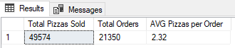
SQL Queries
Average pizzas per order
SELECT
SUM(quantity) AS 'Total Pizzas Sold',
COUNT(DISTINCT order_id) AS 'Total Orders',
CAST(SUM(quantity) * 1.0 / COUNT(DISTINCT order_id) AS DECIMAL(10, 2)) AS 'AVG Pizzas per Order'
FROM pizza_sales;

Slide 9
Charts Requirements
Visualize the following aspects of Pizza Sales:
Daily and Monthly Trend for Total Orders: Create a bar chart that displays trend of total orders over a specific time period. The chart will help identify any patterns or fluctuations in order volumes on a daily basis.
Hourly Trend for Total Orders: Create a line chart that illustrates the hourly trend of total orders throughout the day. This chart will allow to identify peak hours or periods of high order activity.
Percentage of Sales by Pizza Category: Create a pie chart that shows the distribution of sales across pizza categories. This chart will provide insights into the popularity of various pizza categories and their contribution to overall sales.
Percentage of Sales by Pizza Size: Generate a pie chart that represents the percentage of sales attributed to different pizza sizes. This chart will help us understand customer preferences for pizza sizes and their impact on sales.
Total Pizzas Sold by Pizza Category: Create a funnel chart that presents the total number of pizzas sold for each pizza category. This chart will allow us to compare the sales performance of different pizza categories.
Top 5 Best Sellers by Revenue, Total Quantity and Total Orders: Create a bar chart highlighting the top 5 best-selling pizzas based on the Revenue, Total Quantity, Total Orders. This chart will help us identify the most popular pizza options.
Bottom 5 Best Sellers by Revenue, Total Quantity and Total Orders: Create a bar chart showcasing the bottom 5 worst-selling pizzas based on the Revenue, Total Quantity. Total Orders. This chart will enable us to identify underperforming or less popular pizza options.

Slide 10
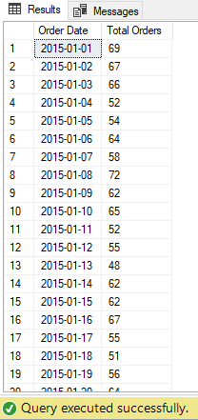
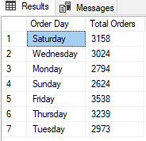
Daily Trend for Total Orders
By day of the week:
select
datename(dw, order_date) as 'Order Day',
COUNT(distinct order_id) as 'Total Orders'
from pizza_sales
group by DATENAME(dw, order_date)
Create a bar chart that displays trend of total orders over a specific time period. The chart will help identify any patterns or fluctuations in order volumes on a daily basis:
Daily order dynamics:
select
order_date as 'Order Date',
count(distinct order_id) as 'Total Orders'
from pizza_sales
group by order_date
order by order_date

Slide 11
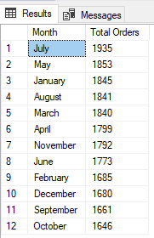
Monthly Trend for Total Orders
Create a bar chart that displays trend of total orders over a specific time period. The chart will help identify any patterns or fluctuations in order volumes on a daily basis:
By month:
select
DATENAME(month, order_date) as 'Month',
count(distinct order_id) as 'Total Orders'
from pizza_sales
Group by DATENAME(month, order_date)
order by [Total Orders] desc

Slide 12
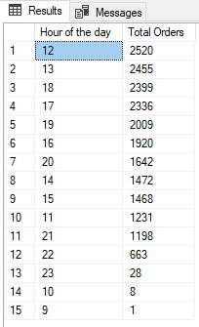
Hourly Trend for Total Orders
DATENAME and DATEPART are SQL Server functions that return the same information but in a different format. The DATENAME function will return the character string-based date and time of a specified date whereas the DATEPART function will return an integer-based date and time of a specified date.
The CAST() function converts a value (of any type) into a specified datatype.
SELECT
DATEPART(HOUR, CAST(order_time AS TIME)) AS [Hour of the day],
count(distinct order_id) as 'Total Orders'
FROM pizza_sales
group by DATEPART(HOUR, CAST(order_time AS TIME))
order by [Total Orders] desc

Slide 13
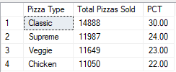
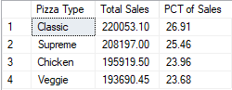
Percentage by Pizza Category
Percentage of Market Share by Quantity:
Select
pizza_category as 'Pizza Type',
sum(quantity) as 'Total Pizzas Sold',
CAST(SUM(quantity)*100/(select SUM(quantity) from pizza_sales) as Decimal (10, 2)) as 'PCT'
From pizza_sales
Group by pizza_category
order by 'PCT' desc
Percentage of Revenue Contribution:
select
pizza_category as 'Pizza Type',
cast(sum(total_price) as decimal (10,2)) as 'Total Sales',
cast(sum(total_price)*100/(select sum(total_price) from pizza_sales) as decimal (10, 2)) as 'PCT of Sales'
from pizza_sales
group by pizza_category
order by 'PCT of Sales' desc
Notes:
In business terms, the concepts you're referring to can be described as follows:
Percentage of Market Share by Quantity: This refers to the portion of the total pizza market that is captured by the sales of a specific type of pizza (in this case, Chicken pizzas) in terms of quantity sold. It helps assess the popularity and demand for a particular pizza category within the overall market.
Percentage of Revenue Contribution: This indicates the relative share of total revenue contributed by a specific type of pizza (in this case, Chicken pizzas) out of the entire revenue generated. It provides insights into the financial significance and profitability of a particular pizza category within the context of overall sales.
These business terms can be used to communicate the significance and impact of Chicken pizzas within the broader context of the pizza sales landscape. They help stakeholders understand the market presence and financial contribution of Chicken pizzas compared to other types of pizzas.

Slide 14
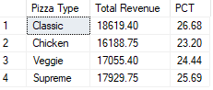
Percentage by Pizza Category with Filtering by Month (for January)
SELECT
pizza_category as 'Pizza Type',
CAST(SUM(total_price) AS DECIMAL(10,2)) as 'Total Revenue',
CAST(SUM(total_price) * 100 / (SELECT SUM(total_price) from pizza_sales where month(order_date) = 1) AS DECIMAL(10,2)) AS PCT
FROM pizza_sales
where month(order_date) = 1
GROUP BY pizza_category

Slide 15

Analysis
Pricing and Revenue: Despite Chicken pizzas having the lowest market share in terms of quantity, they contribute a relatively higher revenue percentage compared to their market share. This suggests that Chicken pizzas might have a higher average selling price or more premium pricing.
Strategic Focus: Considering the revenue contribution, there might be an opportunity to focus on promoting and enhancing Chicken pizzas to further capitalize on their higher revenue potential.

Slide 16
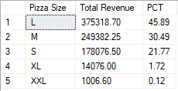
Percentage of Sales by Pizza Size
SELECT
pizza_size as 'Pizza Size',
CAST(SUM(total_price) AS DECIMAL(10,2)) as 'Total Revenue',
CAST(SUM(total_price) * 100 / (SELECT SUM(total_price) from pizza_sales) AS DECIMAL(10,2)) AS 'PCT'
FROM pizza_sales
GROUP BY pizza_size
order by 'PCT' desc
Note: if you want to filter by quarters just add
WHERE clause into your query and sub-query:
WHERE DATEPART(quarter, order_date)={number of Q}

Slide 17
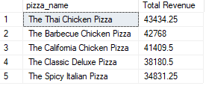
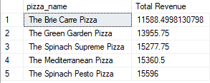
Top 5 Best Sellers and 5 Lowest Selling (in terms of revenue)
Top 5 Best Sellers:
select top 5
pizza_name,
sum(total_price) as 'Total Revenue'
from pizza_sales
group by pizza_name
order by 'Total Revenue' desc
5 Lowest Selling Pizzas:
select top 5
pizza_name,
sum(total_price) as 'Total Revenue'
from pizza_sales
group by pizza_name
order by 'Total Revenue' asc

Slide 18
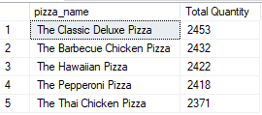
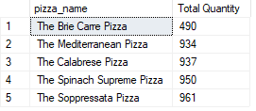
Top 5 Best Sellers and 5 Lowest Selling (in terms of quantity)
Top 5 Best Sellers:
select top 5
pizza_name,
sum(quantity) as 'Total Quantity'
from pizza_sales
group by pizza_name
order by 'Total Quantity' desc
5 Lowest Selling Pizzas:
select top 5
pizza_name,
sum(quantity) as 'Total Quantity'
from pizza_sales
group by pizza_name
order by 'Total Quantity' asc

Slide 19
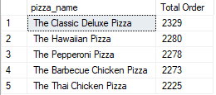
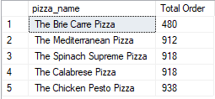
Top 5 Best Sellers and 5 Lowest Selling (in terms of orders)
Top 5 Best Sellers:
select top 5
pizza_name,
count(distinct order_id) as 'Total Order'
from pizza_sales
group by pizza_name
order by 'Total Order' desc
5 Lowest Selling Pizzas:
select top 5
pizza_name,
count(distinct order_id) as 'Total Order'
from pizza_sales
group by pizza_name
order by 'Total Order' asc

Slide 20

Visualizations
Let’s dive in

Slide 21
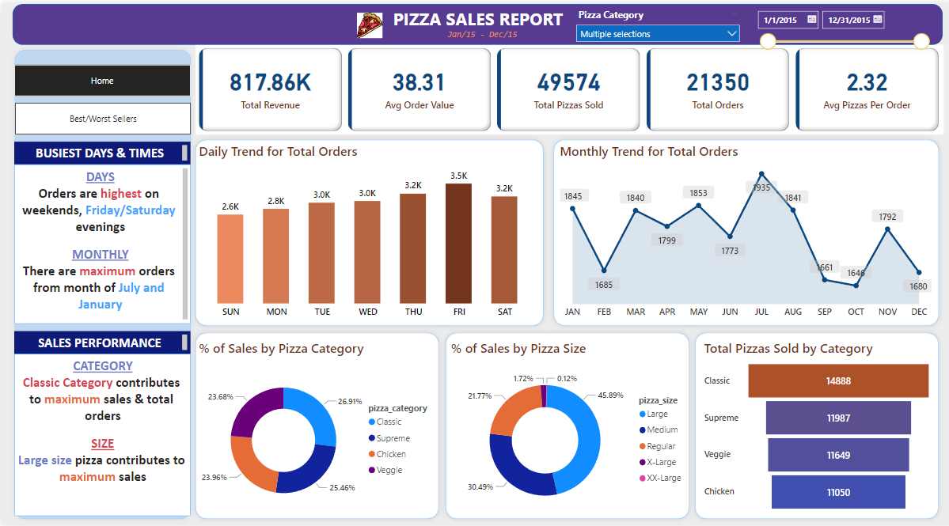
Dashboard 1

Slide 22
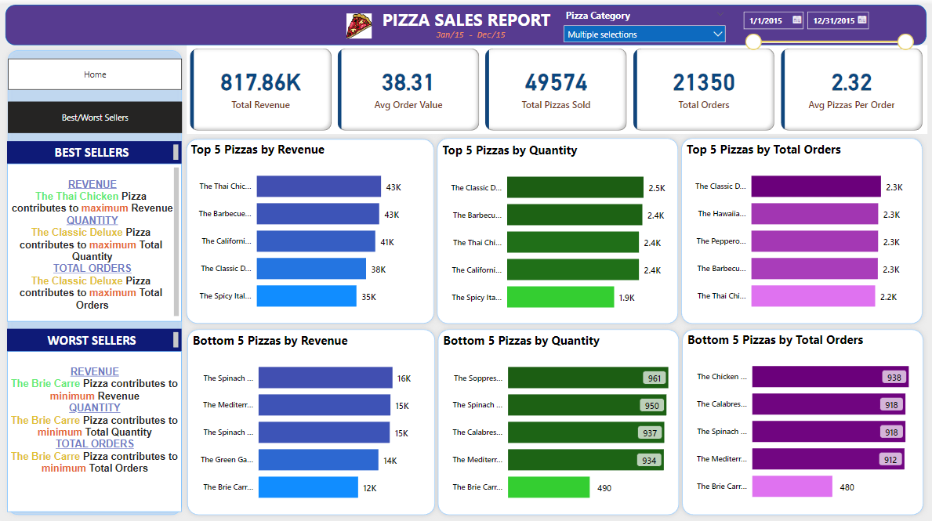
Dashboard 2

